Slide 1
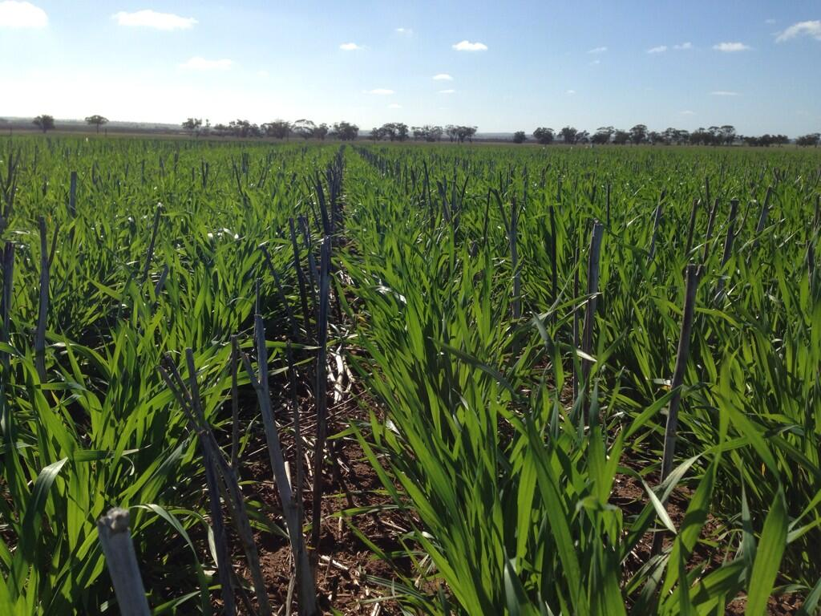


Cereal Growth stages
The link to crop management
Ken Flower and Brenton Leske

Slide 2
Cereal growth stages
Why is this important?
Management by growth stages is critical to optimise returns from inputs such as nitrogen fertiliser, herbicides (in some cases), fungicides, irrigation

Slide 3
G x E x M
Genetics x Environment x Management

Slide 4
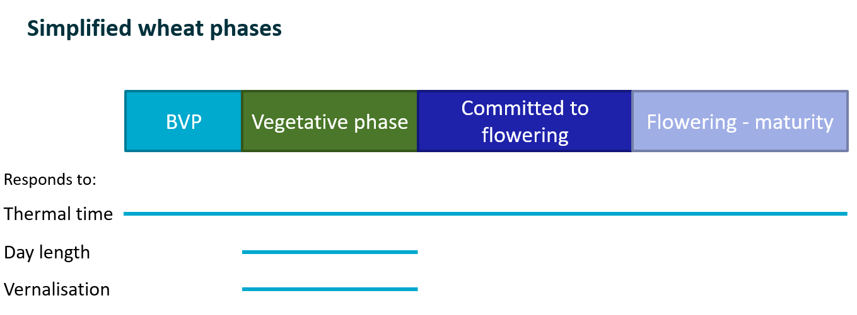


G = genetics: 🌾
Each wheat variety contains different combinations of genes that affect the speed of development
  Eg. VRN1, PPD1
Mace, Scepter
Winter wheat, long spring types
Diagram from Andrew Fletcher, CSIRO

Slide 5
Thermal time
Every phase of development requires a minimum accumulation of temperature before that stage can be complete and the plant can move to the next stage.
In effect, the plant senses the temperature every day and adds the average for that day to a running total up to the total required for the stage.
This running total is called thermal time or the heat sum for the phase, minus base temperature, and the thermal units are degree days (°Cd).
You can calculate it in the same way by totalling the mean temperatures for each day during the phase.
Mean temperature is maximum + minimum divided by 2.
So if the day had a maximum of 35° C and a minimum of 15° C the mean would be 25° C (35 + 15 divided by 2) and the heat sum for the day would be 20° Cd (25 – 5 (base))

Slide 6

E = environment:
What are the drivers of crop development?
Temperature (thermal time - mean temperature, °Cd) 🔥
Vernalisation (vrn - cold requirement) ❄️
Photoperiod (ppd – long day response) ☀️
Earliness per se (inherent differences when ppd and vrn have been accounted for)
They determine the period of time (number of days) between germination and flowering.
Notes:
Earliness per se is the differences in time to heading when photoperiod and vernalisation have accounted for

Slide 7
M = Management:
Best management of the crop to maximise yield and profits needs knowledge of:
  Crop development (Zadoks scale)
  Timing of inputs (N, fungicide, herbcides)
  Economic response
Notes:
Earliness per se is the differences in time to heading when photoperiod and vernalisation have accounted for

Slide 8
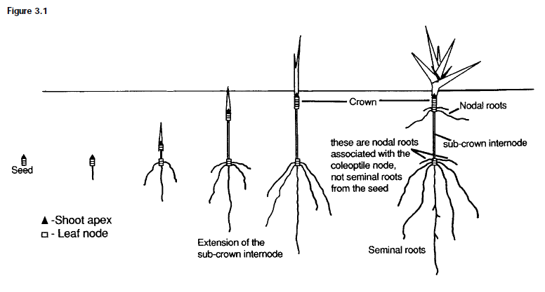
Cereal growth stages:
The Wheat Book: Principles and Practice
(DAFWA/GRDC)

Slide 9

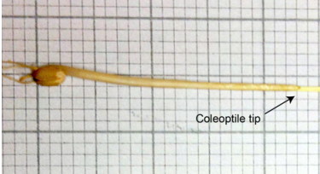
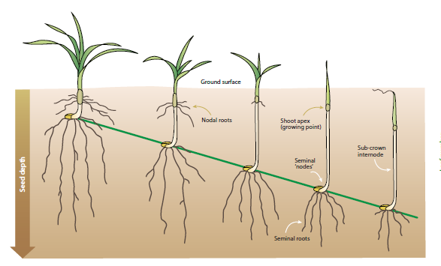
Cereal growth stages:
GRDC Grow notes – Wheat Western

Slide 10
Cereal growth stages
Zadoks Cereal Growth Stage Key is most commonly used:
Divides in 10 distinct stages
Each stage denoted by the prefix GS (i.e. growth stage) OR Z (Zadoks) GS39 or Z39

Slide 11
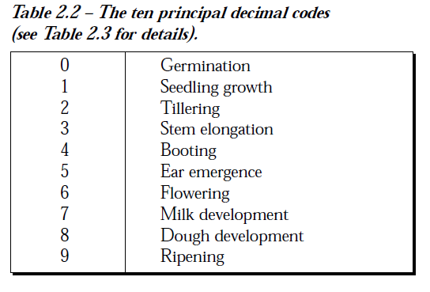
Cereal growth stages

Slide 12

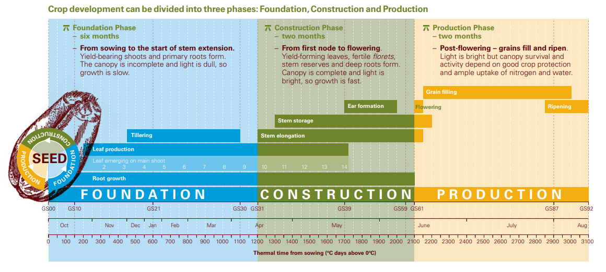

Slide 13
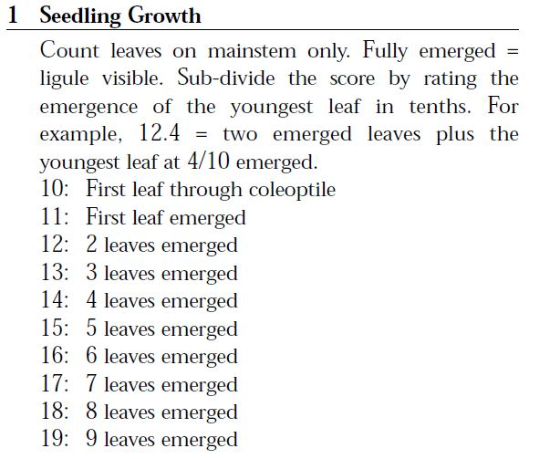
The Wheat Book – Principles and Practices

Slide 14
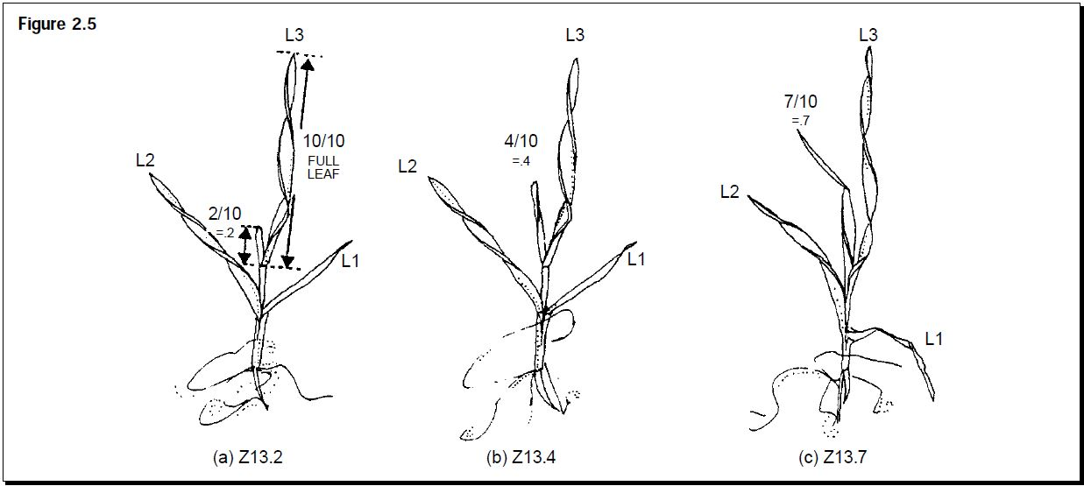
The Wheat Book – Principles and Practices

Slide 15
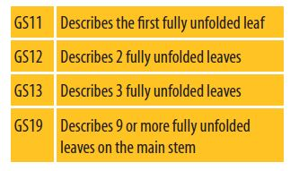
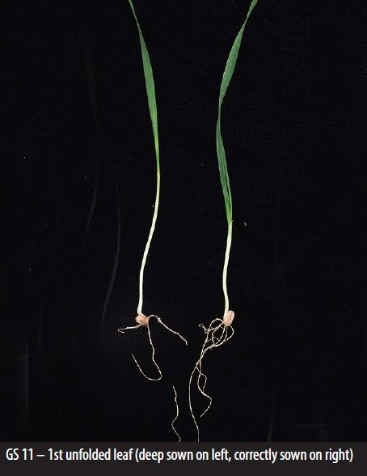
Cereal growth stages GS1
(Seedling)
Number of leaves on main stem may vary from 5 to 20

Slide 16
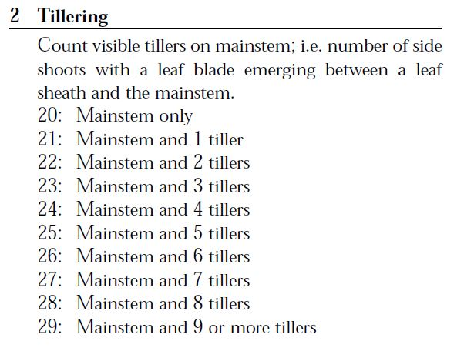
The Wheat Book – Principles and Practices

Slide 17
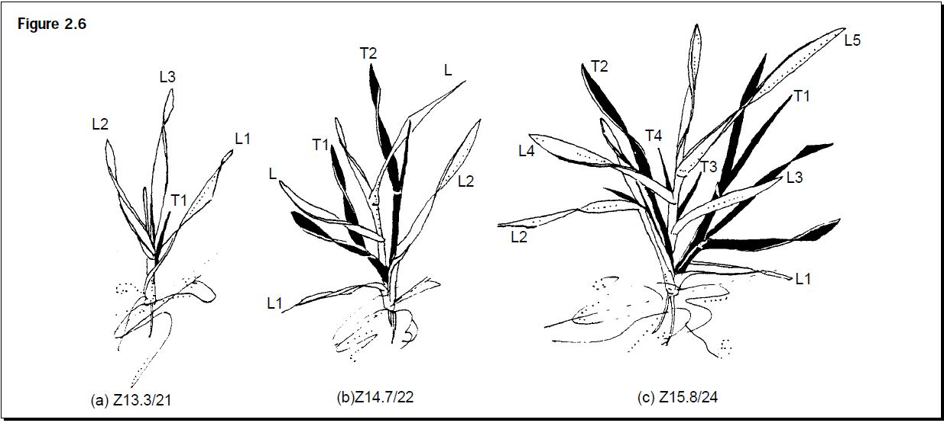
The Wheat Book – Principles and Practices

Slide 18
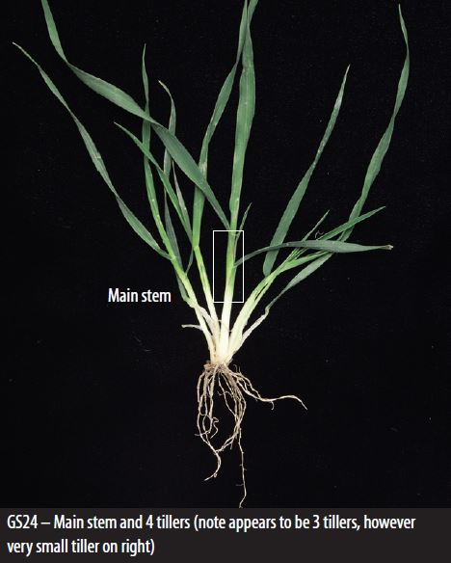
Cereal growth stages 2 (Tillering)
Early nitrogen
Low N = ⬇️ tillers
High N = ⬆️ tillers
⬆️ crop canopy biomass
⬆️ final ear number
? more disease
? enough 💧 to finish the crop, will I make a profit

Slide 19
Cereal growth stages 2 (Tillering)
2,4-D amine herbicide
In WA - Apply from the 5 leaf stage up to jointing stage (Zadoks 15-33).
Apply after the 6 leaf stage (Z.16) for Cranbrook, Jacup, Aroona
and Spear wheat and Mortlock oats to avoid possible damage.

Slide 20
Cereal growth stages 2 (Tillering)
2,4-D amine herbicide
Apply after the first node can be felt at the base of a tiller and
before swelling of the head can be felt in a tiller (NSW, ACT, SA
only).
Very early sprayed plants have a fused flag leaf that resembles an onion leaf.
Susceptible plants start to twist and appear distorted

Slide 21
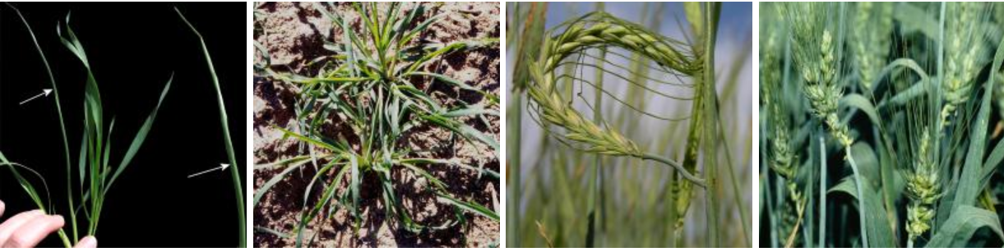


Cereal growth stages 2 (Tillering)
2,4-D amine herbicide
-Very early sprayed plants have a fused flag leaf that resembles an onion leaf.
-Susceptible plants start to twist and appear distorted

Slide 22
In many cereal crops:
3 leaf (on main stem) stage is before tillering.
5 leaf (on main stem) stage coincides with early tillering. 6–7 leaf (on main stem) stage coincides with mid to fully tillered stage.
Jointing or node formation indicates the start of the reproductive phase in the crop, and tillering can be said to be complete, i.e. fully tillered.

Slide 23
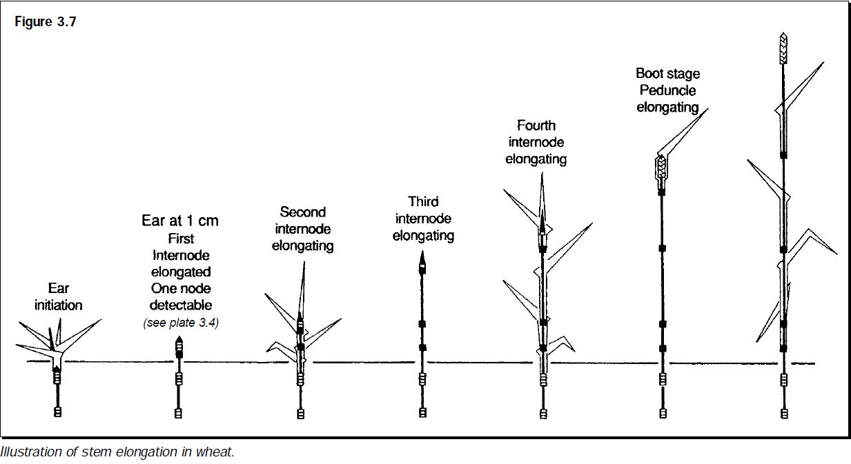
Cereal growth stages:
The Wheat Book: Principles and Practice
(DAFWA/GRDC)

Slide 24
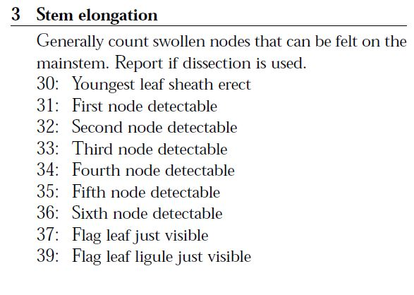
The Wheat Book – Principles and Practices

Slide 25
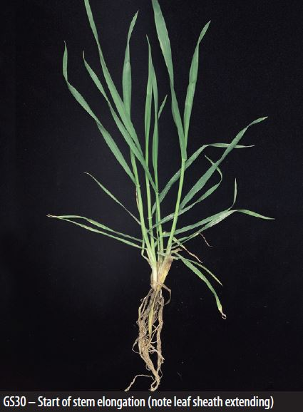
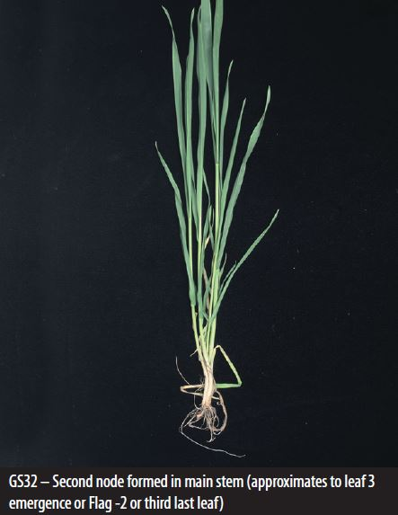
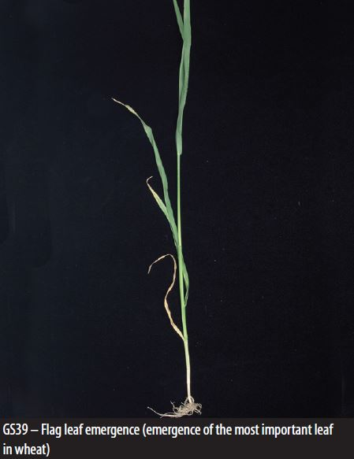
Cereal growth stages 3 (Stem elongation)
Low nitrogen (during stem elongation) = reduced tillers and canopy size but may not reduce yield. Late N may increase grain size (more time for decisions)

Slide 26
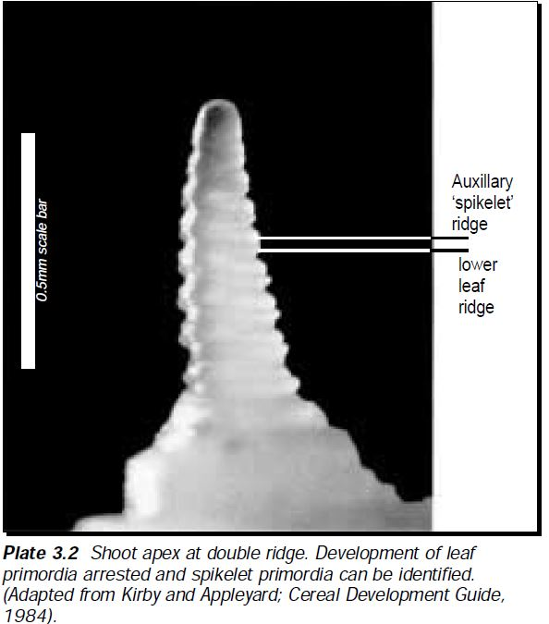
Floral initiation:
Double ridge stage identified by dissection. Occurs just before stem elongation (about Z29/Z30)

Slide 27
Cereal growth stages 3 (Stem elongation)
If disease (rust etc) is present, it is important to protect the flag leaf on the main stem in wheat – so spray at flag leaf emergence (GS39). In barley it is the Flag – 1 (leaf below the flag is the largest) and must be protected if disease is a major risk

Slide 28
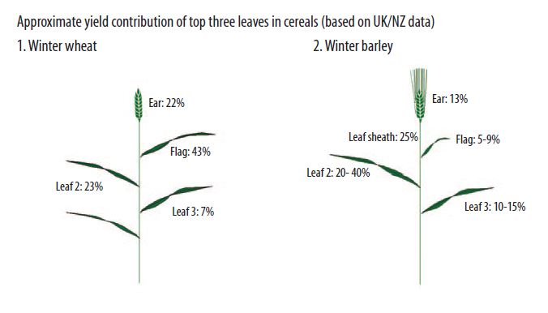
Cereal growth stages 3 (Stem elongation)

Slide 29
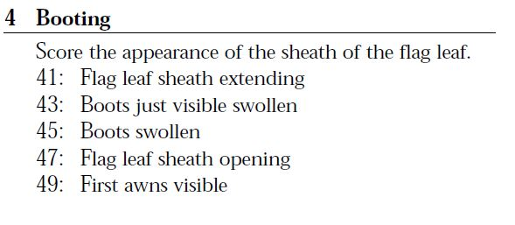
The Wheat Book – Principles and Practices

Slide 30
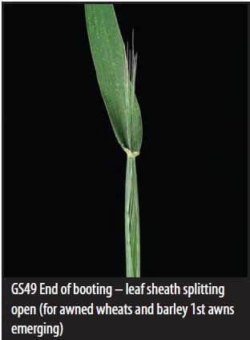
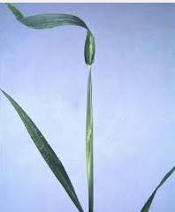
Cereal growth stages 4 (Booting)
Flag leaf

Slide 31
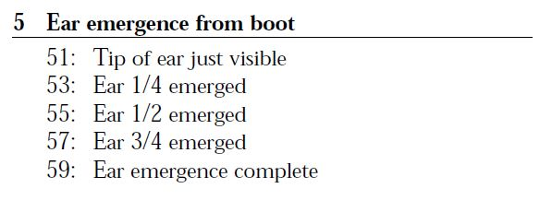
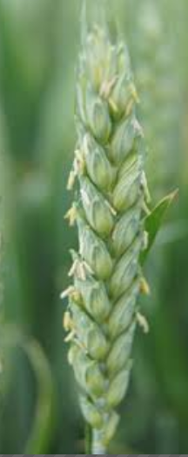
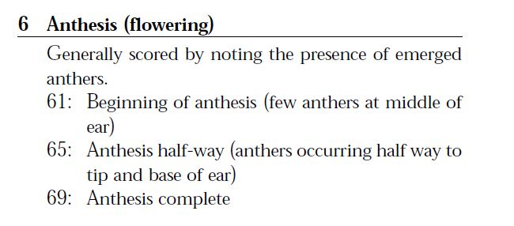
The Wheat Book – Principles and Practices

Slide 32
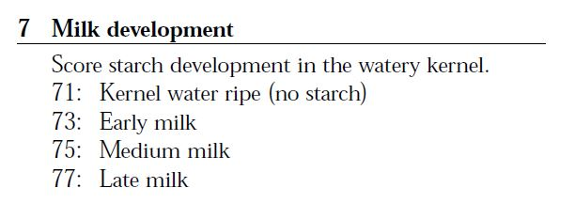
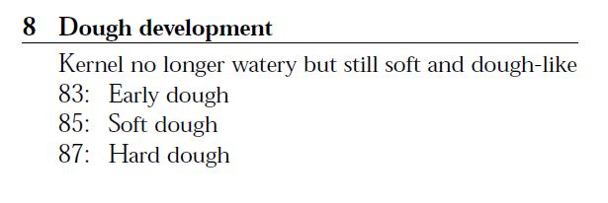
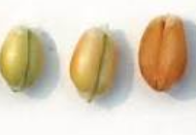
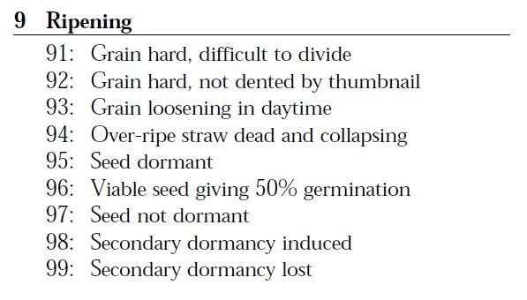
The Wheat Book – Principles and Practices

Slide 33
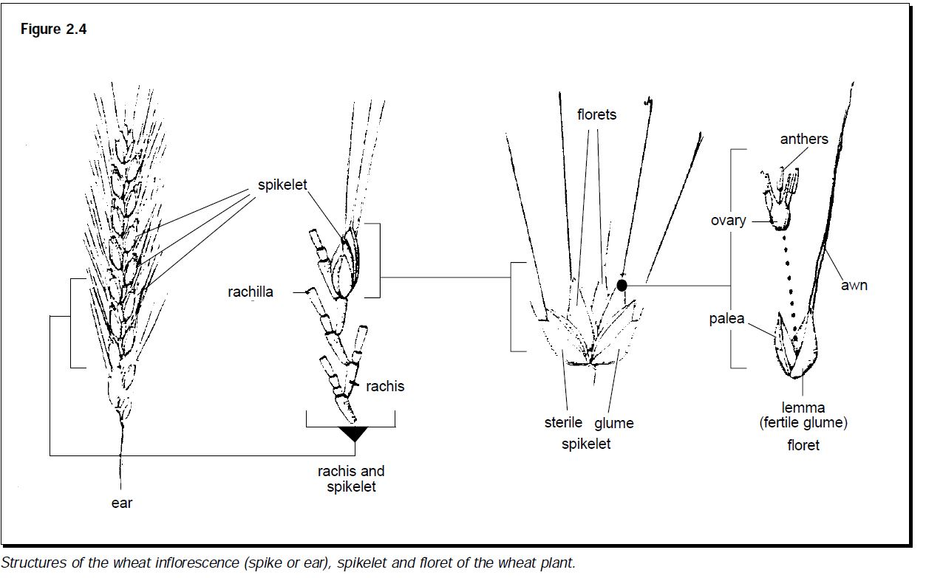
The Wheat Book – Principles and Practices

Slide 34
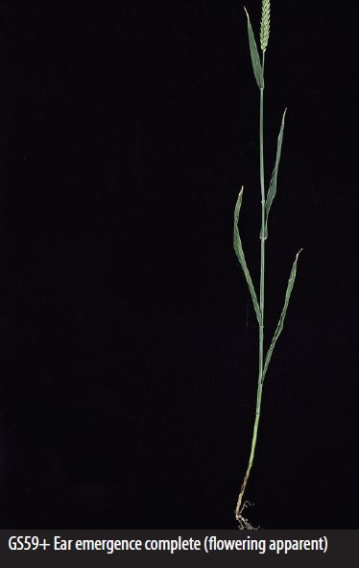
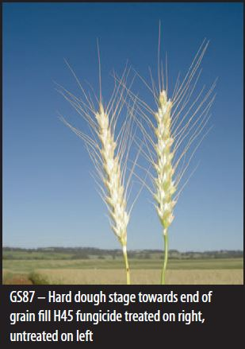
Cereal growth stages 5-9 (Ear emergence through to Ripening)

Slide 35
Key points:
The Zadoks growth stage key does not occur in chronological order
  Eg. a plant with 3 fully formed leaves begins to tiller (Z 20/GS 20) before leaves 4-6 have fully formed
Once the plant starts developing tillers it is easier to determine the development stage by tiller number than leaf number – due to senescence
It is possible to have different parts of the plant at different stages. However it is scored by the most advanced part
  Eg. a plant with 2 nodes (Z 32), 3 tillers (Z 23), and 7 leaves (Z 17). This would be scored Z 32

Slide 36
Key points:
From Z 30 the development stage describes the main stem and not an average of the tillers

Slide 37
Cereal growth stages
Growth stages in relation to canopy management:
Disease and late nitrogen management mainly from start of stem elongation to early flowering (Z30 – Z61)
Late N applications can boost grain protein

Slide 38
Cereal growth stages
Stem elongation Z30-33
Important for both nitrogen timing and protection (fungicide) of key leaves. To ensure correct identification of the GS, plant stems are cut longitudinally, so that the internal movement of the nodes and internodes (hollows) can be measured

Slide 39
Cereal growth stages:
The Wheat Book: Principles and Practice
(DAFWA/GRDC)

Slide 40

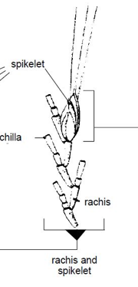
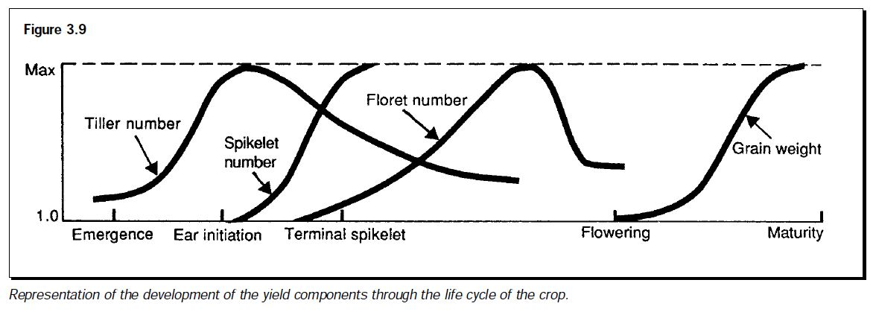
Set number of ears
Set number of spikelets
(3-5 leaves on main stem)

Slide 41
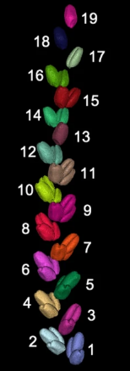
Zhou, H., Riche, A.B., Hawkesford, M.J. et al. Determination of wheat spike and spikelet architecture and grain traits using X-ray Computed Tomography imaging. Plant Methods 17, 26 (2021). https://doi.org/10.1186/s13007-021-00726-5

Slide 42
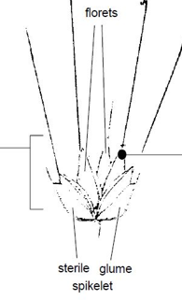
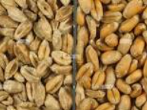
Set number of ears
Set number of spikelets
(3-5 leaves on main stem)
Set number of grains/spikelet
(Flowering)
Grain weight

Slide 43
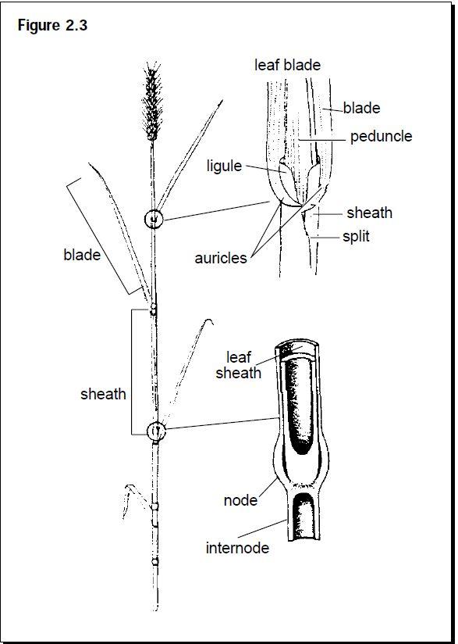
Cereal growth stages:
The Wheat Book: Principles and Practice
(DAFWA/GRDC)
https://www.agric.wa.gov.au/wheat/wheat-book-principles-and-practice

Slide 44
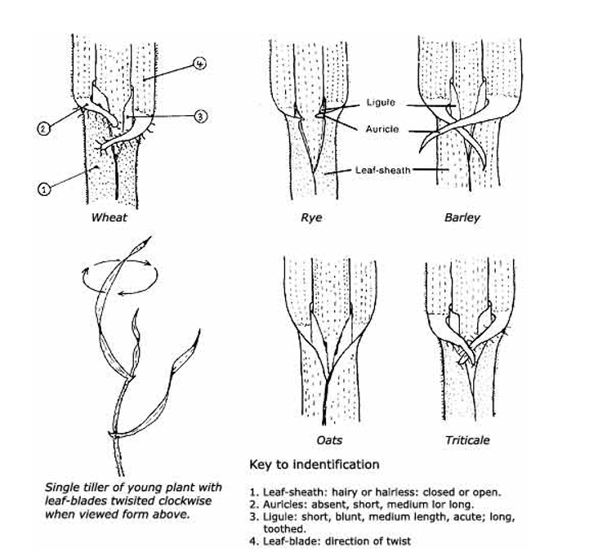

Slide 45
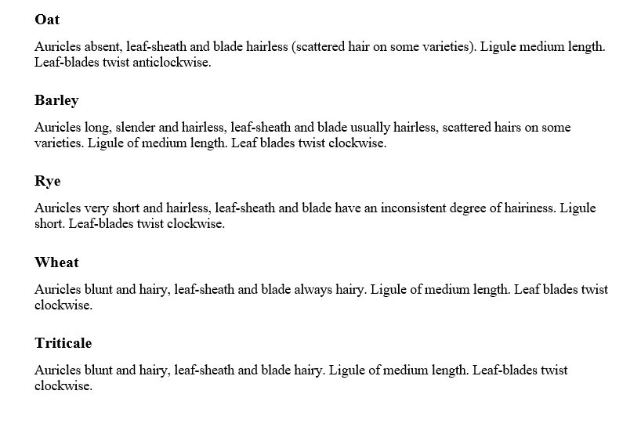

Slide 46
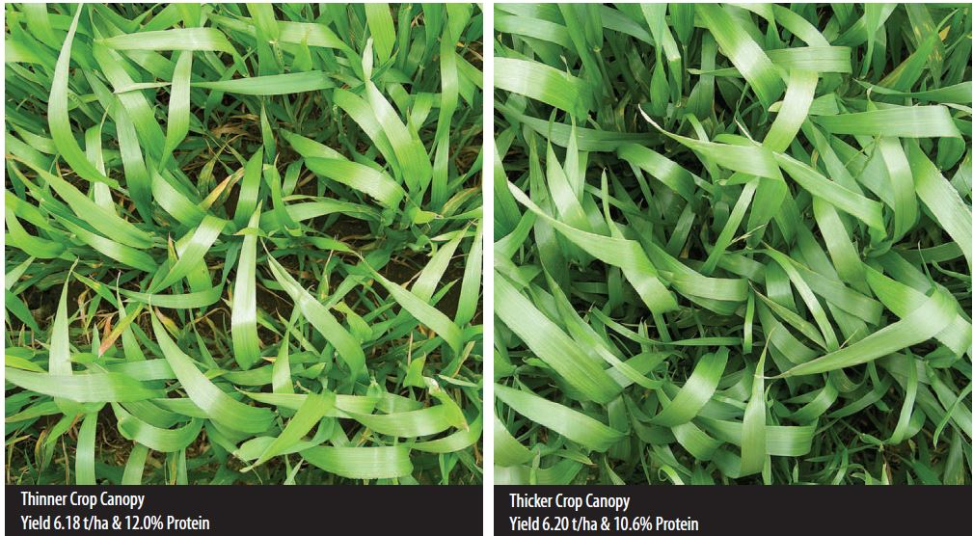
Canopy Management
Management of the green surface area of the crop canopy in order to optimise crop yield and inputs
Notes:
Canopy management: thicker – pros: generally higher yield, compete with weeds through shading
Thicker – cons: potentially more disease, greater frost damage risk
In this example the target protein is an important consideration. Is the high yield worth the reduction in protein (wheat grade) and the cost of application and product?

Slide 47

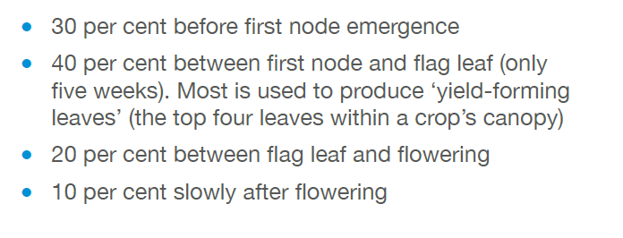
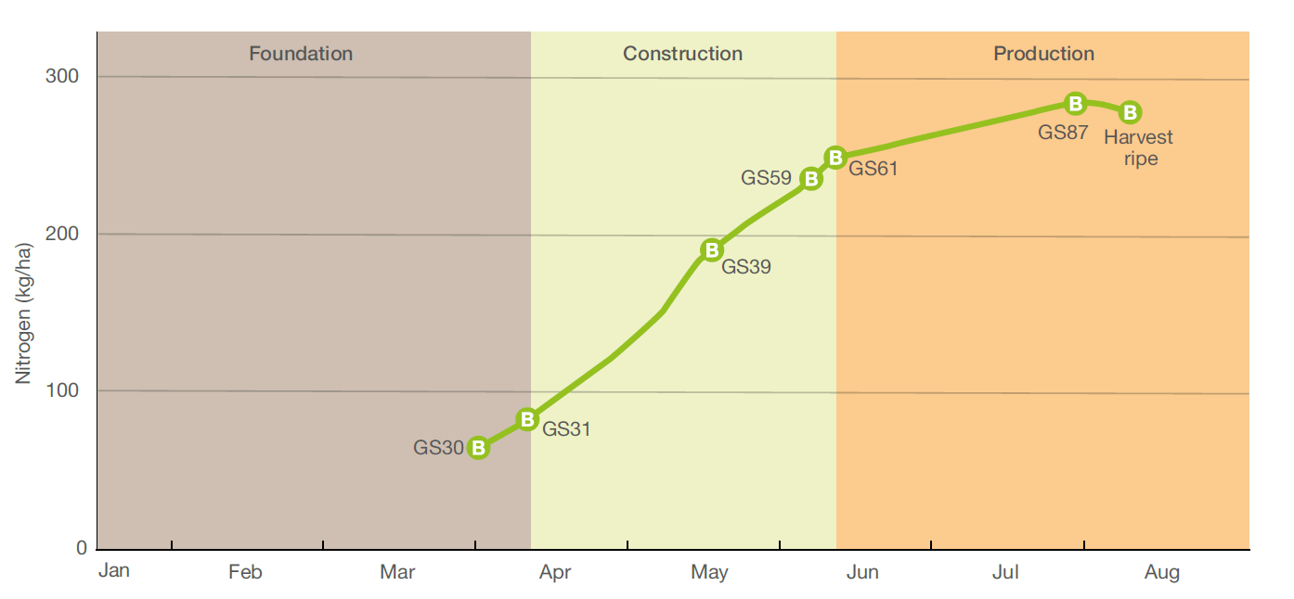
N Uptake by wheat

Slide 48
Cereal growth stages
Why is this important?
Management by growth stages is critical to optimise returns from inputs such as nitrogen fertiliser, herbicides (in some cases), fungicides, irrigation

